Slide 1
Software Engineering Studio 3A Project Pitch
Team
Graphics created by Ullupta conecum re volupta evelignis pe et doluptuam.

Slide 2

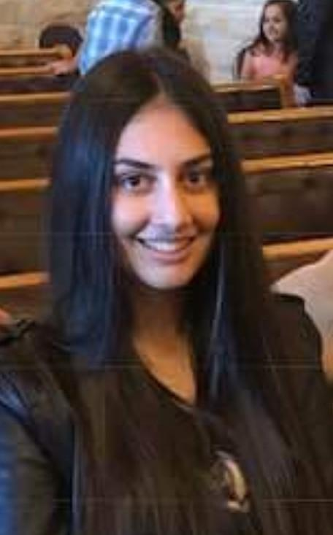

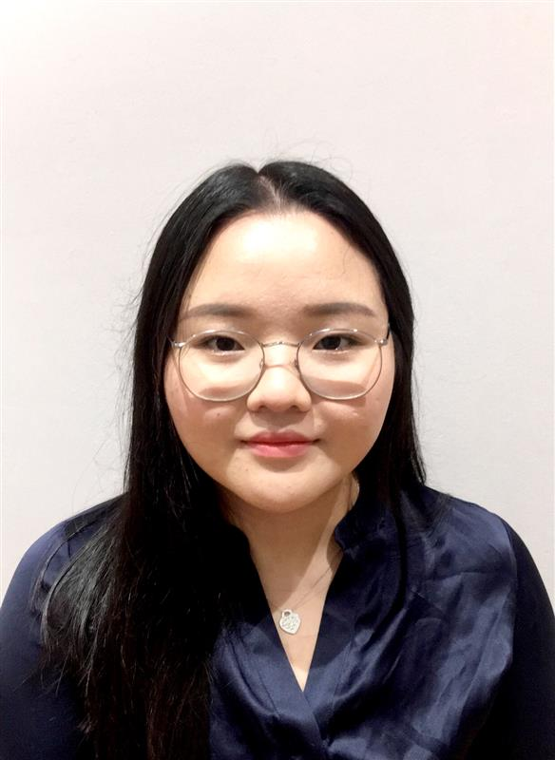

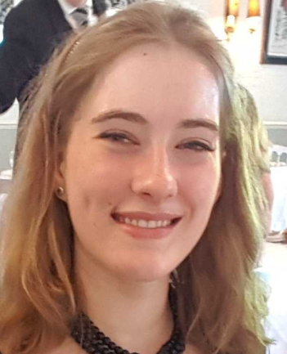
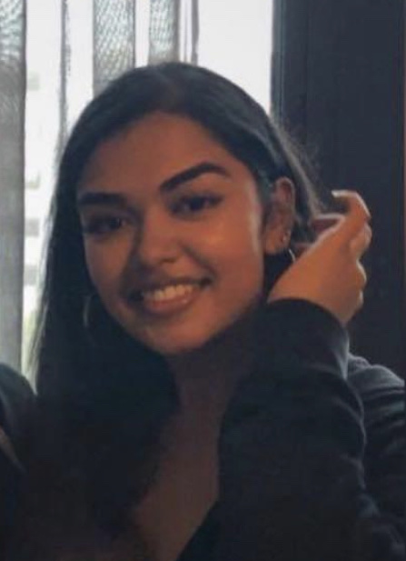


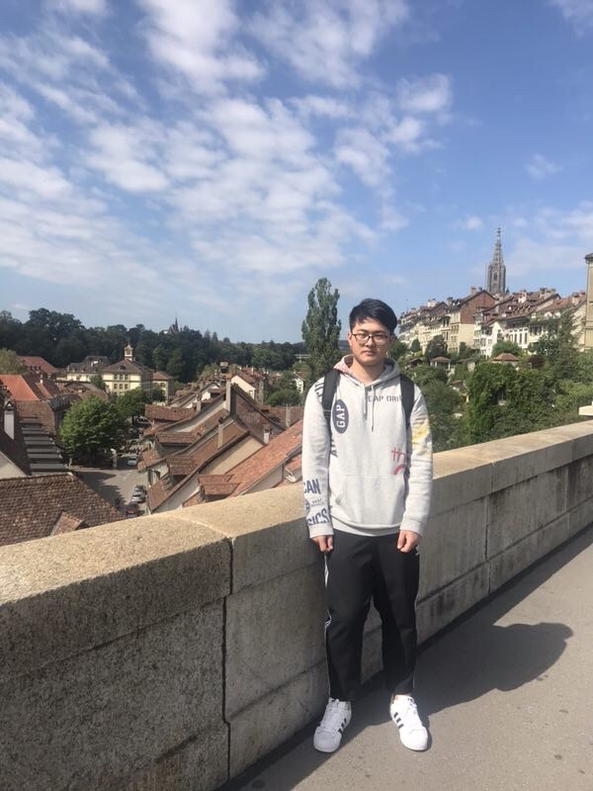
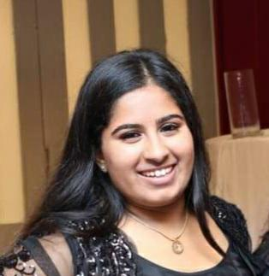
Your Team and Members
Data Science
Front-End
Back-End
Database/Security
Project Manager
Saanchi
Jasmine
Koshin
Michelle
Piyush
Alexa
Amrita
Saanchi
George
Nuo
Jeevika

Slide 3
Project Scope
FRIENDS is a crisis management and avoidance system.
It provides civilians (everyday people) with a way to view crisis relative to themselves, track and message who they know, contact emergency services and view crisis procedures.
Provides authorities (trained people) a way to warn civilians, track on-going crisis, provide and request resources, communicate to civilians, and find people at risk.

Slide 4
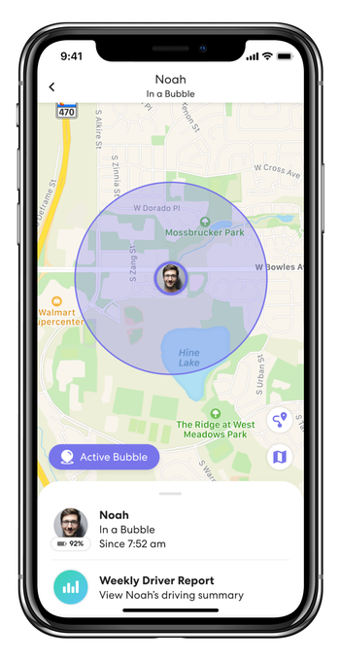
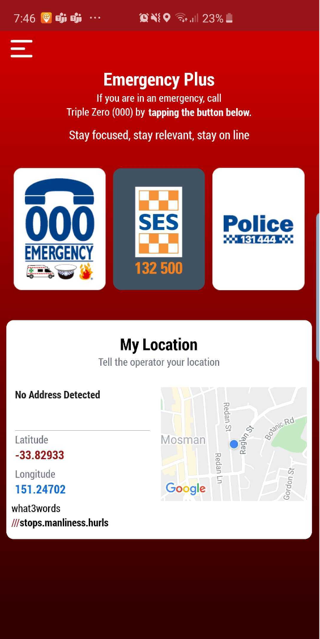
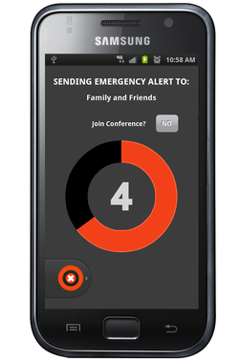
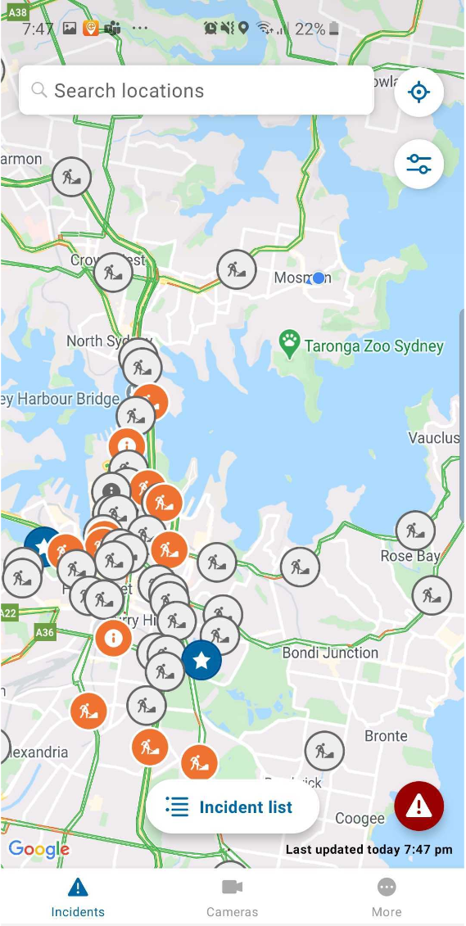
The Problem
People have a huge AMOUNT and VARIETY of risks they can be exposed to
How should they approach these? What is best?
Currently no centralised solution
LIFE360
EMERGENCY PLUS
GAURDLY
LIVE TRAFFIC NSW

Slide 5
Civilian Needs
Aware of dangers and risks relative to themselves
Track people they know
Be able to communicate with others, both professionals and friends
Be able to quickly get help at their location
Know what to do in a crisis
Contact emergency services with ease
Want to be protected
WANT TO HAVE ALL THESE FEATURES IN ONE LOCATION

Slide 6
Authority Needs
Warn civilians of dangers
Be informed of dangers and their locations
Track people in danger
Ensure civilians are aware of what to do in a crisis
Provide sufficient resources for a crisis
BE ABLE TO MANAGE EVERYTHING IN ONE LOCATION

Slide 7

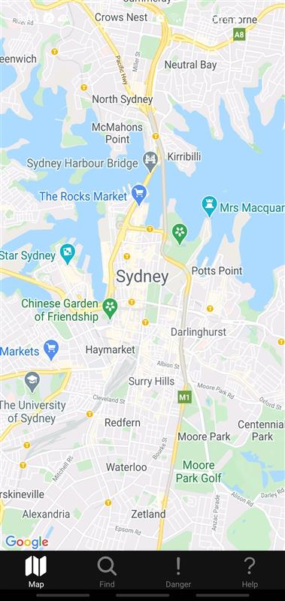
The Solution: FRIENDS
For
Rescue
In
Emergency
aNd
Daily
Situations
Notes:
FRIENDS is a scalable, secure and intuitive system which centralises the existing approaches taken to help civilians minimise their risk in their everyday lives.

Slide 8
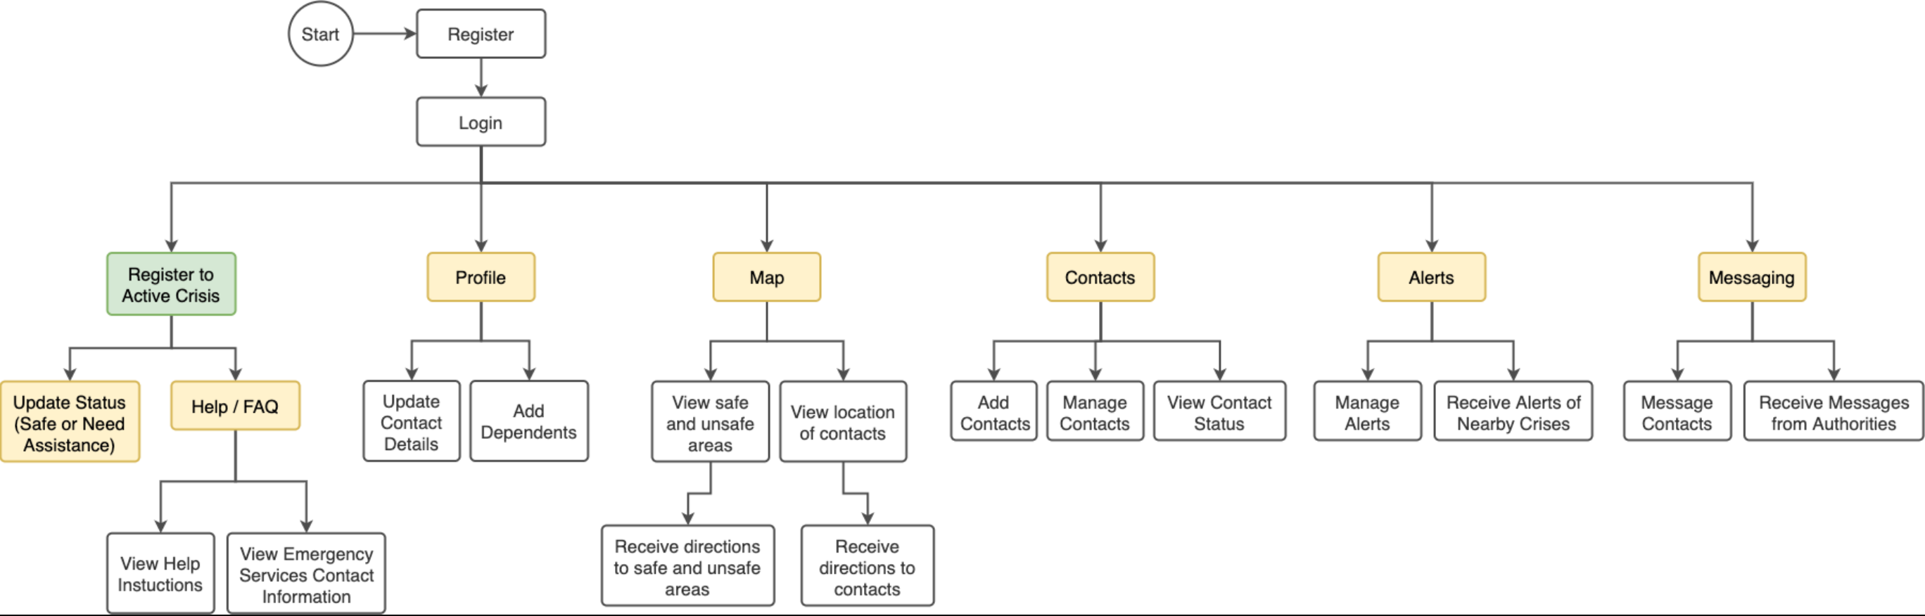
Civilian Features

Slide 9
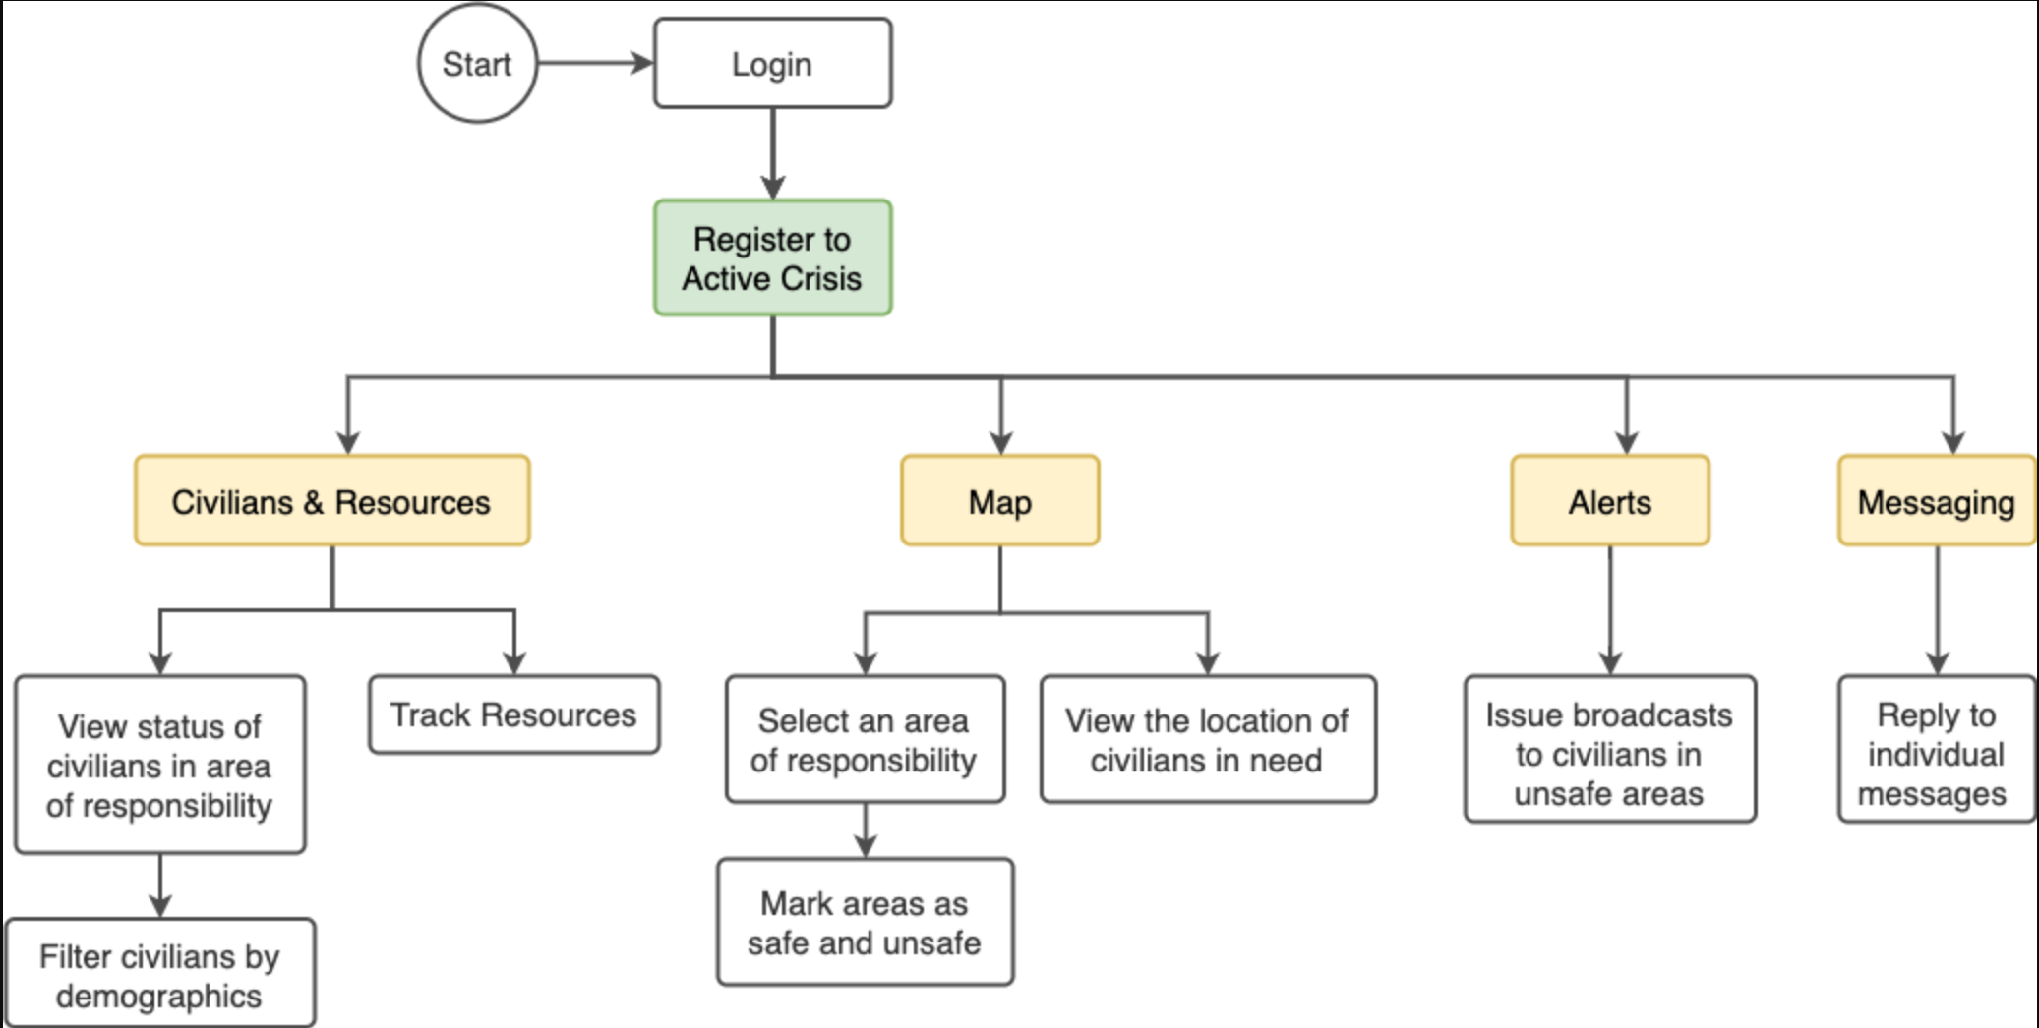
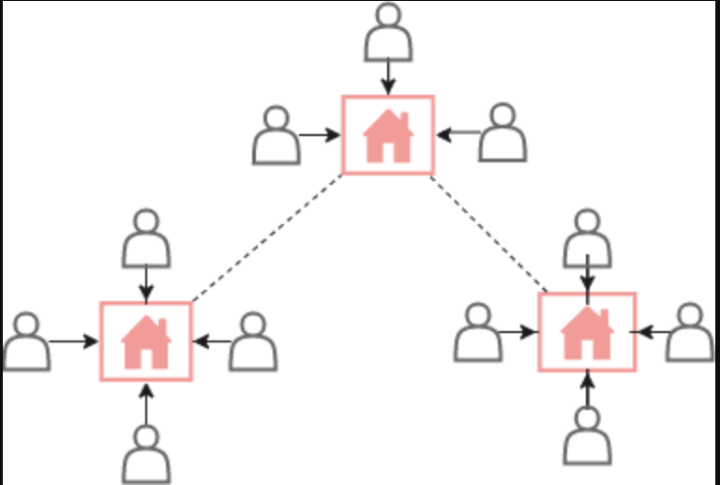
Authority Features
Active Crisis Network

Slide 10
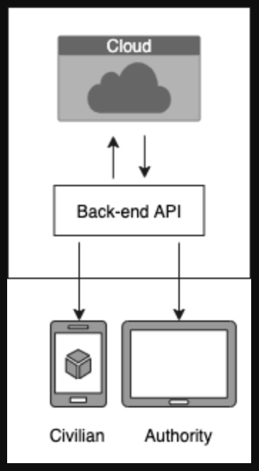
The Tech
ARCHITECTURE
Cloud data storage with encryption
Custom back-end API in Python
Front-end in React
CAPABILITIES
Cross-platform
Highly scalable
Secure
Potential to integrate to existing systems

Slide 11
Project Timeline – Sprint 1
Cost of this sprint: $1,800
TO-DO
Help
Alerts
Messaging
Security
Resource Info
Acceptance Testing
Final Refinements
User Manual
Demo Video
IN PROGRESS
Architecture Initialised
Register
Map
User Tracking
DONE

Slide 12
Project Timeline – Sprint 2
Cost of this sprint: $1,400
TO-DO
Messaging
Security
Resource Info
Acceptance Testing
Final Refinements
User Manual
Demo Video
IN PROGRESS
User Tracking
Help
Alerts
DONE
Architecture Initialised
Register
Map

Slide 13
Project Timeline – Sprint 3
Cost of this sprint: $1,400
TO-DO
Resource Info
Acceptance Testing
Final Refinements
User Manual
Demo Video
IN PROGRESS
Messaging
Security
DONE
Architecture Initialised
Register
Map
User Tracking
Help
Alerts

Slide 14
Project Timeline – Sprint 4
Cost of this sprint: $1,400
TO-DO
Final Refinements
User Manual
Demo Video
IN PROGRESS
Resource Info
Acceptance Testing
DONE
Architecture Initialised
Register
Map
User Tracking
Help
Alerts
Messaging
Security

Slide 15
Project Timeline – Sprint 5
Cost of this sprint: $1,400
TO-DO
IN PROGRESS
Final Refinements
User Manual
Demo Video
DONE
Architecture
Register
Map
User Tracking
Help
Alerts
Messaging
Security
Resource Info
Acceptance Testing

Slide 16
Project Management
Microsoft Teams – communication, meetings and storing documents
Github – track contributions
Front-end:
https://github.com/jasmine-nahrain/SS3A_Frontend
Back-end:
https://github.com/pv0192/SS3B_Backend
Database:
https://github.com/JeevikaL/Database-SS3A
Documentation: https://github.com/saanchimaheshwari/SS3A_documentation
Trello - track overall progress and feature content
Feature Progress: https://trello.com/b/X4CxHrmb/feature-progress
User Stories: https://trello.com/b/eW5UgL3i/user-stories

Slide 17
Thank you

